Slide 1


Ecole nationale Supérieure d’Ingénieurs de Reims
The Engineering School from the University of Reims
3 engineering majors:
Packaging engineering
Energy engineering
Environmental and urban planning engineering (since 2020)
1 Master’s degree in Sustainable urban planning
1 preparatory class after high school (on Parcoursup) (since 2020)
Public school, University tuition fees
Open day: February 1, 2025 (9am-5pm) www.esireims.fr

Slide 2
Reims
Dynamic city at the heart of the East region.
Home to the most prestigious champagne houses, Reims is a city of cultural, sporting, economic and academic effervescence...
Only 45 minutes from Paris by TGV!

Slide 3
Admissions 2-year undergraduate degree
ESIREIMS
CPGE (preparatory classes) Admissions:
MP, PC, PSI: Polytech competitive exam – Preregistration: www.scei-concours.fr
BCPST, ATS, PT…: Attestation of eligibility for a competitive exam – Recruitment on file and interview
2-year university undergraduate degree (L2, L3, BUT) Admissions:
L2, L3: Any scientific training.
BUT: Any scientific ‘BUT’ (Scientific Technical Bachelor’s degree) according to the major:
  Packaging: Physical measurements, Packaging, Mechanical and production engineering, Chemistry engineering, Chemistry, Bio engineering, Material science and engineering
  Energy: Physical measurements, Energy and thermal engineering, Mechanical and production engineering, Civil engineering, Material science and engineering…
  Environmental urban planning: Civil engineering and sustainable building, Energy and thermal engineering, Physical measurements, Mechanical and production engineering, Bio engineering (environmental engineering), Networks and telecommunications…
  Applications to be submitted on eCandidat (URCA website)

Slide 4
Admission after a high school diploma
ESIREIMS
ESIREIMS engineering preparatory class (2 years):
Admissions after a high school diploma on Parcoursup: CPI-ESIREIMS
Scientific high school diplomas: Math, Physics-Chemistry, Biology and Engineering Sciences
For any information on admissions:
Please contact: scol.esireims@univ-reims.fr

Slide 5
ESIREIMS engineer syllabus
Core curriculum courses for the three majors (30%):
Scientific courses: Math, Physics, Chemistry, Materials resistance…
Economic, social and human sciences: Management, Sustainable development, Marketing, Negotiation…
Communication: Expression techniques, English (TOEIC compulsory – B2 level), second foreign language…
Specialty courses:
Packaging: Materials, Mechanization, Logistics, Printing Techniques, Container-Content Interactions, Design, Eco-Design, CAD-CAM, Prototyping…
Energy: Heat Transfers, Industrial Energy, Heat Exchangers, Climate Engineering, Renewable Energies, Energy Diagnostics…
Environmental urban planning: Operational urban planning, Sustainable city, Territorial planning, Urban project, Roads and various networks, Territorial ecology, Urban planning and environmental law, Smart city…

Slide 6
ESIREIMS engineer syllabus
Internships:
Students will have spent one year in companies over 3 years:
11 weeks spent abroad at the end of their 1st year
4-5 months at the end of their 2nd year
4-6 months at the end of their 3rd year (graduation project)
International perspectives:
Internships abroad (starting during the first year)
Gap year
One Erasmus semester, or one semester outside Europe

Slide 7
Packaging engineering
The ESIREIMS Packaging engineer
is a Project Manager specialized in Packaging engineering

Slide 8
Packaging at the heart
of societal and environmental issues
Eco-designed packaging for a product
To contain
To inform
To showcase
Product
To protect
To preserve
To transport
The packaging industry:
Ranked 8th in French industries (same ranking as the aerospace industry)
110,000 positions
850 schools
+ € 25 billion (turnover)

Slide 9
Who is a
PACKAGING engineer?
Project Manager
with good communication skills
He/she is a
working in…
team
on…
different missions
He/she evolves in …
companies
in an…
international environment
in collaboration
company departments (Purchasing, quality, production marketing...)
He/she works…
with…
suppliers,
subcontractors,
clients

Slide 10
Packaging engineering jobs
Missions
Eco-design, development, packaging optimization, CSR approach
Definition of specifications, choice of materials, management of the graphic chain - Document management
Market analysis, search for suppliers, deployment of an ethical and responsible purchasing strategy
Quality tests, homologation - Traceability - Transport and logistics
C

Slide 11
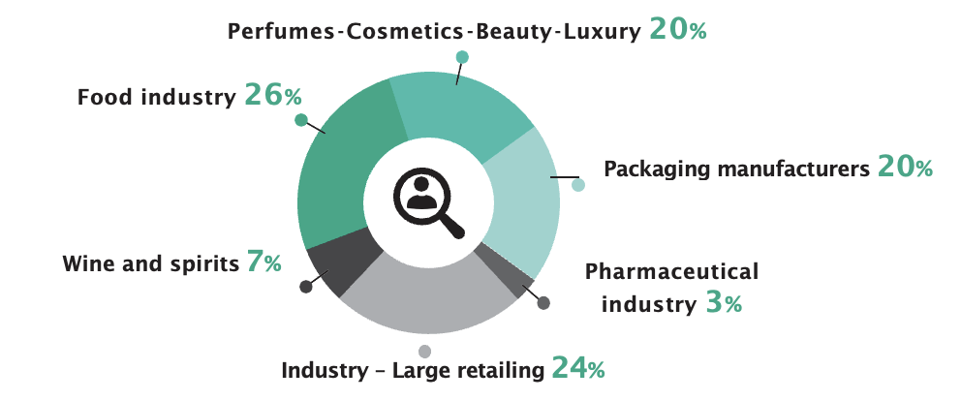
Packaging engineering jobs
Business sectors

Slide 12
Packaging engineering occupational integration
Top-level multidisciplinary training close to industrial realities
Average time to find a job: 2 months.
Average starting salary: €36,000 € (annual gross, without bonuses) (2019)
30 % of graduates take their first job abroad.
Training based on social skills and expertise skills
Career flexibility and adaptability

Slide 13
Energy engineering
The ESIREIMS Energy engineer
is a Project Manager specialized in Energy and Thermal engineering

Slide 14





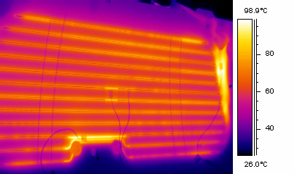
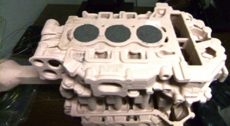
Energy balances of buildings and industries…
Energy engineering
Production
Exploitation
Transport
Storage
Energy
Resources
management
To assess
Balances
Materials
Processes
Heat
transfers
Calculations
Optimization
Heat engineering
… to materials and systems heat analyses.

Slide 15
Who is an ENERGY engineer?
Project Manager Business Manager
Energy efficiency
He/She is a…
Thermal calculations
working on…
missions
work sites
such as …
Fluids optimization
He/She evolves in…
Consulting firms
or in…
the industry
to provide answers to objectives related to…
The COP21 Paris Agreement
The Green Growth Energy Transition Act

Slide 16
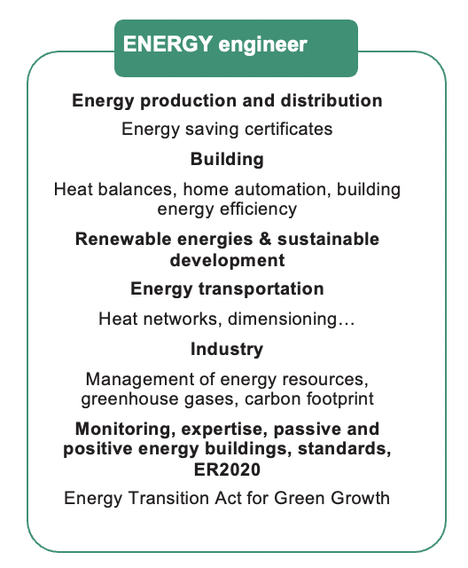
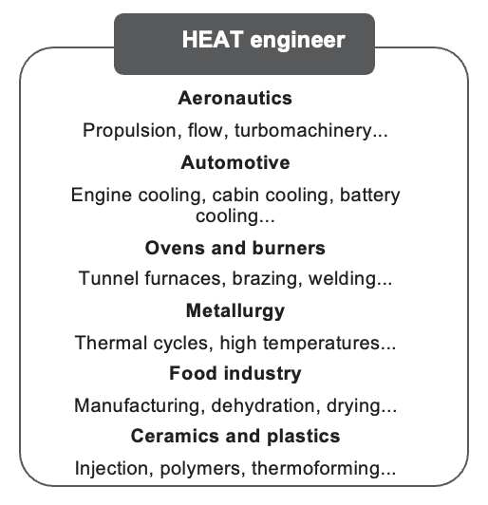
Energy engineering jobs
Jobs
C

Slide 17
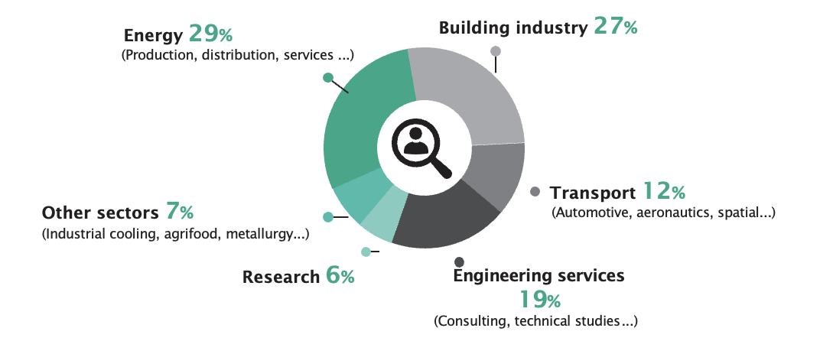
Energy engineering jobs
Business sectors

Slide 18
Energy engineering occupational integration
A training in Energy and Thermal engineering close to industrial realities!
53% Energy engineers – 37% Heat engineers - 10% others
Average time to find a job: 2 months
Average starting salary: €36,000 € (annual gross without bonuses) (2019)
Continuation of studies: 12% of PhD…

Slide 19
Environmental and urban engineering
The ESIREIMS Urban and Environmental engineer is
a Project Manager specialized in Urban and Environmental engineering

Slide 20
Urban Engineering and the transition to territorial sustainability
Design
studies
Networks
management
Urban engineering
Resources
management
Energy
efficiency
Environment
Materials
respecting
the environment
To assess
Balances

Slide 21
Who is an Environmental and Urban engineer?
He/She is a …
Project Manager
with good communication skills
polyvalent
He/She evolves in…
consulting firms
the building industry
the public service (collectivities, ‘DREAL’, ‘DDT’...)
He/She works …
in collaboration
with…
actors in urban planning
actors in territorial development

Slide 22
Environmental and
Urban engineering jobs
Missions
Urban networks coordination and management
On-site energy control
Territories strategic planning
Territories identification and planning
Design, management and revaluation of renewable energies sites
Sustainability policies management
Description of energy-efficient urban projects

Slide 23
Environmental and
Urban engineering jobs
An answer to the emergence of new professions:
Urban planning engineer
Urban infrastructures planning Manager
Project engineer – Urban planning and project management
Districts energy strategy project engineer
Territory energy planning engineer
Environment/Energy market Researcher
Renewable energy Manager
Territories planning and environmental regulation project engineer
Environmental Project Manager
Environmental engineering Project Manager
Access to territorial engineer competitive exams

Slide 24
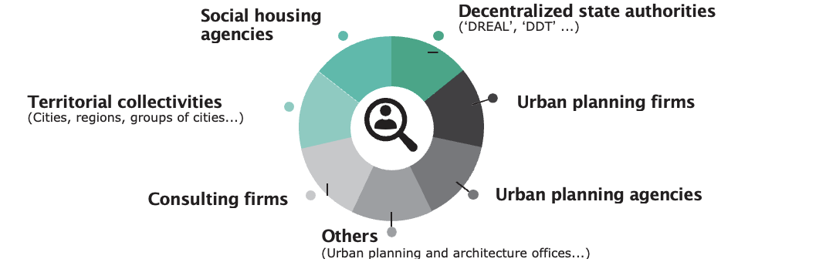
Environmental and
Urban engineering jobs
Business sectors

Slide 25

Master’s degree in Urban Planning
“IATEUR”
The IATEUR (Reims Institute of Territorial, Environmental and Urban Planning) trains urban planners, taking sustainability into account. Our training program emphasizes the environmental dimensions of planning policies and the complexity of the different fields and techniques in sustainable urban planning.
Students are taught contemporary evolutions and the development of new tools, as well as decisions systems and governance logics.
2 thematic majors are offered during the 2nd year: 1 / Temporal urban planning and town chronotopic approach; 2 / Urban planning in the countryside: agro-urban spaces reconfiguration.
We have developed several international partnerships which enable students to be trained abroad as well, and to obtain a double degree at the University of Venice (IUAV).

Slide 26
Who is an urban planner?
The urban planner is an expert in urban and territorial creation and operation. He/she coherently organizes spaces while having a global and/or localized reflection. Trained to have a cross-disciplinary vision which takes spatial, environmental and socio-economic concerns into account, he/she analyzes, offers and designs territorial planning.
Consulting firms, design offices
Network public services operators
Territorial authorities
Real estate and private planning firms
State administration and national agencies

Slide 27
Jobs
Master’s degree in Sustainable Urban Planning
At the end of their studies, after having a lot of professional experiences, students will be able to become Operations Managers and Project Managers in public or privates structures such as territorial authorities, regional services, urban planning firms, urban planning agencies or consulting firms.
Our Master’s degree also offers the possibility to pursue studies to get a PhD.
Some jobs examples:
- Environmental, Energy… operations Manager;
- Operational urban planning Project Manager;
- Territorial development Project Manager;
- Real Estate Manager;
- Market Researcher in design offices.

Slide 28
Occupational integration
Master’s degree in Sustainable Urban Planning
80% of our students find a job within the 6 months after their graduation. Indeed, thanks to workshops and internships, they are ready to work very quickly and our training and degree have been well-known for about 50 years among urban planning professionals.
Our training program has been certified by:
- APERAU (Association for the Promotion of Research and Studies in Urban Planning);
- OPQU (Professional Office of Urban Planners Qualification);
- AESOP (Association of European Schools of Planning).

Slide 29
In-company training program
More than 20 programs intended for industrialists - 1 day to several days/weeks courses:
Packaging introduction - book of specification,
Packaging certification and qualification protocol,
Materials (wood-paper-cardboard), industrial design, metal materials,
Corrosion and metal protection, plastic materials, interactions,
Glues and adhesives, printing techniques - colorimetry,
Plastic packaging recycling and the environment,
Design: the visible face of packaging
Biosourced and biodegradable plastic materials,
Smart packaging, techniques and machines, barcodes
Energy and Thermography, Metrology...
- Contracted and customizable programs
- From September to July.
- Estimate on request
Stéphanie Odof, in charge of Continuing Education
stephanie.odof@univ-reims.fr

Slide 30
APEL / VPE
VPE: validation of professional experience to pursue studies to get a Master’s degree in Sustainable Urban Planning or a Packaging Engineer diploma or an Energy Engineer
  After passing a commission, possibility to follow the university curriculum for engineering degrees without having the necessary prerequisites.
APEL: accreditation of prior experiential learning to obtain a Packaging Engineer diploma or an Energy Engineer diploma
  Admissibility
  Report redaction
  Oral presentation in front of a jury of experts
Information:
Stéphanie Odof, in charge of Continuing Education
stephanie.odof@univ-reims.fr

Slide 31
Support ESIREIMS and reduce your taxes with a DONATION
Thanks to your generosity, you can reduce your taxes such as:
your income tax
your wealth tax
your corporate income tax
The National Engineering School of Reims is authorized to receive direct donations from individuals and companies.
Contact and information:
  stephanie.odof@univ-reims.fr

Slide 32
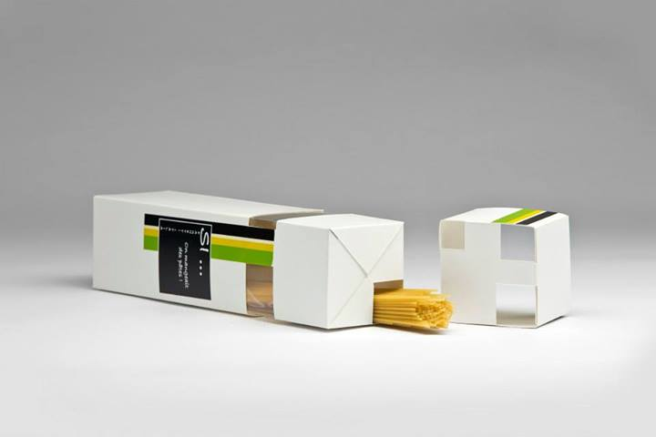
ESIREIMS also…
Participates in Packaging design contests:
PACKAGING PIDA: Packaging Impact Design Awards
Oscars de l’Emballage
Participates in packaging design national projects:
  Example: F.R.I.P.E /EMMAUS with containers to
collect second-hand clothes in companies…

Slide 33
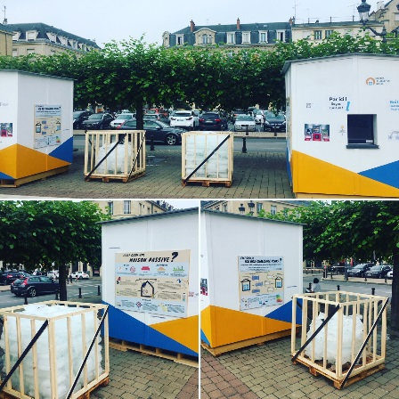
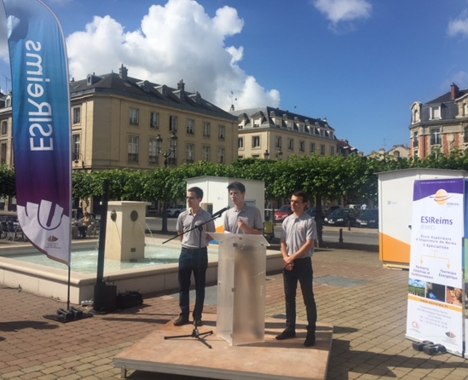
ESIREIMS is also about…
The Ice box Challenge in Reims: a unique event in France
A scientific experiment conducted at the heart of Reims!
Thermal comfort proved by ice!
iceboxchallengereims.fr

Slide 34
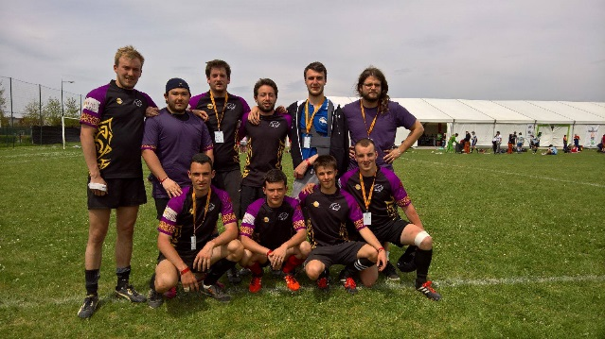
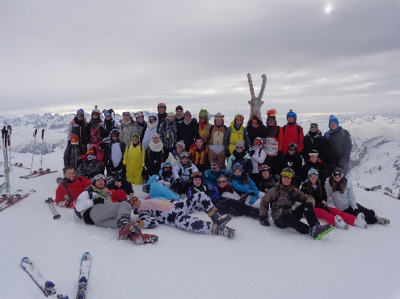
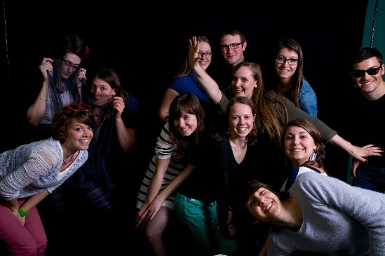
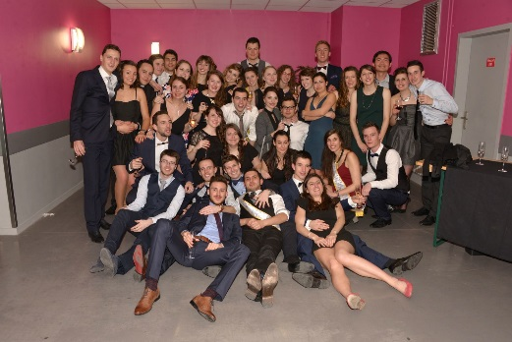
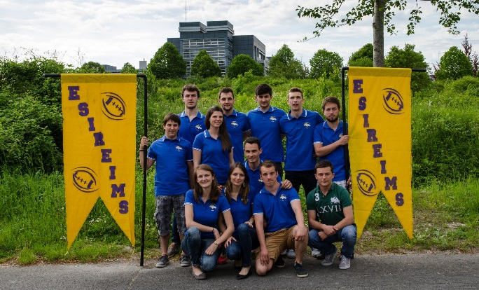
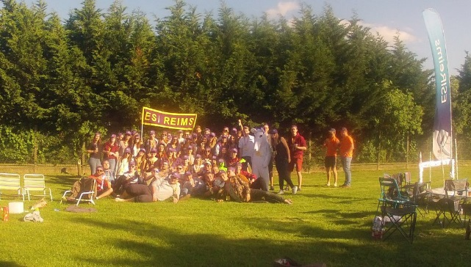
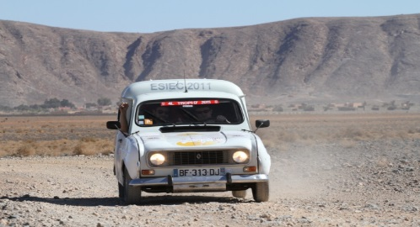
ESIREIMS is also about…
very dynamic school projects!
4L Trophy

Slide 35
ALUMNI networks in France and abroad
ESIREIMS also has…
AMPAC (Packaging Alumni network) more than 1,000 graduate members all around the world
ATHER (Energy Alumni network)
Associ’ateur (IATEUR Alumni network)
Industrial partners
ESIREIMS Gala sponsors
Interns recruitments
Research and development, and consulting services
In-company trainings
Test services…

Slide 36
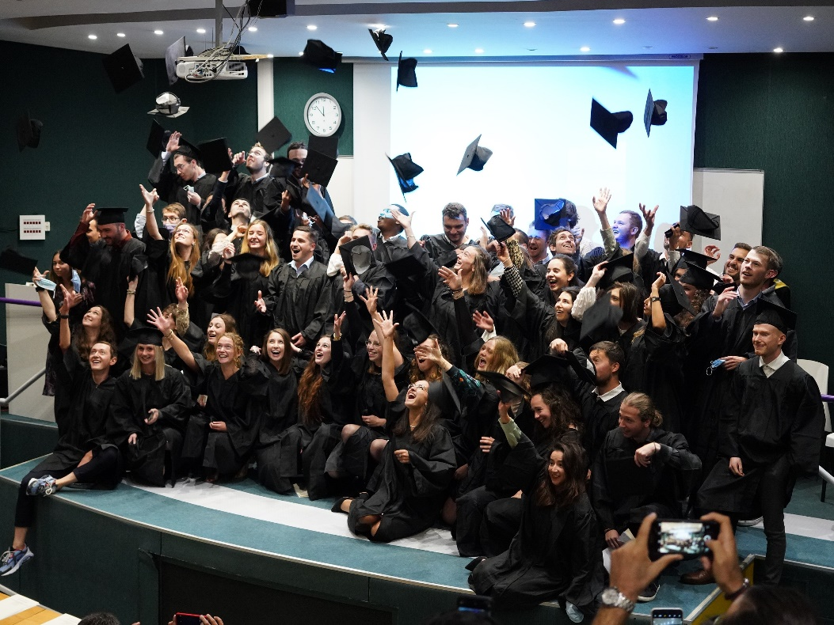
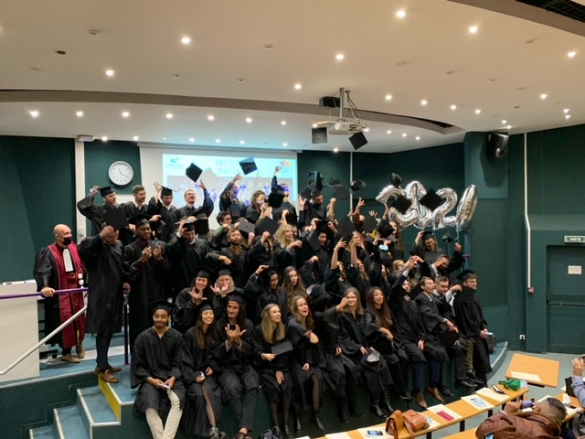
ESIREIMS is also about…
festive graduation ceremonies!

Slide 37

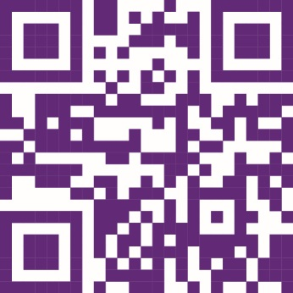
Packaging engineering coordinator damien.erre@univ-reims.fr
Energy engineering coordinator
herve.pron@univ-reims.fr
Environmental and Urban engineering coordinator
Benoit.dugua@univ-reims.fr
ESIREIMS video
4Oth anniversary video
Virtual tour

Slide 38

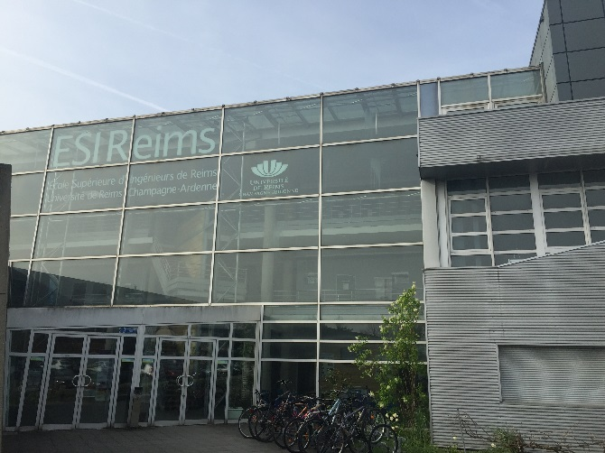



Open day February 1, 2025
3 esplanade Roland Garros
51100 Reims, France
www.esireims.fr @ESIReims
esireims
ESIReims Communication
ESIReims ESIReims

